Slide 1
RETAIL ANALYSIS

Slide 2
Customer Analysis
Demographic Insights
Credit Limit Analysis
Sales Analysis
Product Analysis
Revenue Analysis
Profit Analysis
Order Analysis
Inventory Insights
Payment Analysis
Order Pattern
Shipping Analysis
Employee Analysis
Payment Trends
Employee Distribution
Employee Performance
Access how credit limits are distributed across different customer segments
Analyze high volume and high value orders
Cancellation Order Analysis
Customer Life Time Value
Evaluate revenue and profit generated by customer
Top Selling Products
Analyze total revenue by region, customer , product & time
Evaluate overall profit trends and identify high profit region & customer
Pinpoint best-selling products and their performance by region.
Price Analysis
Analyze the impact of pricing on sales volume & revenue
Track stock levels & identify slow moving or overstocked items
Evaluate average shipping time by region
Evaluate overall return cancellation rate
Assess total payement per month or year
Rank employee by total revenue generated
Compare employee count across offices.
Evaluate customer distribution across regions
MECE Breakdown:

Slide 3
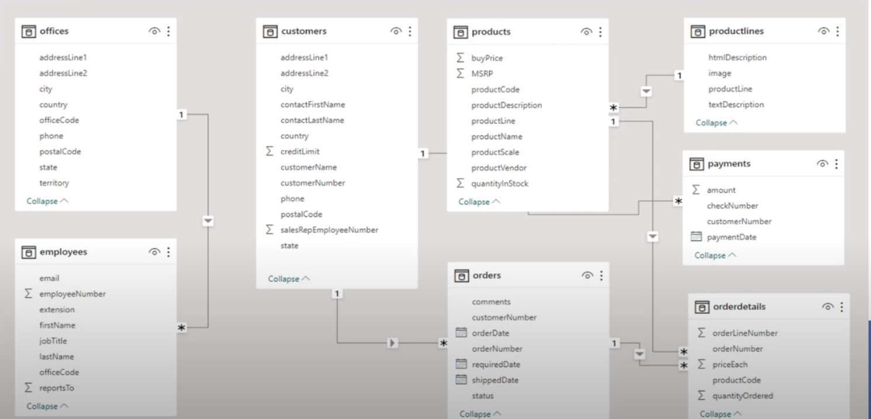
ER Diagram:

Slide 4
EDA Questions

Slide 5
1. Which factors contribute to the highest sales in a particular region?
Factors contributed to the highest sales in Madrid city:
1. Classic Cars are the leading product line and the primary revenue driver for Madrid.
2. There is a clear relationship between quantity sold and revenue, although higher-priced products like Classic Cars or Vintage Cars might generate significant revenue with fewer units.
3. Seasonality plays a role in driving sales, especially during the end-of-year months, making these periods critical for maximizing revenue.

Slide 6
2. How can customer purchasing patterns be influenced to increase average order value?
1. Day-wise Analysis:
Monday and Saturday have the lowest AOV, so focus on Monday and Saturday with targeted discounts or bundled offers to encourage higher spending. Investigate why Sunday has the highest AOV and replicate similar conditions (e.g., product availability, promotions) on other days.
2. Monthly Trends:
Use months with historically high AOV (e.g., Feb, Aug) to analyze successful strategies and replicate them in months with dips. Introduce periodic campaigns to smooth fluctuations and ensure steady growth.
3. Customer Segmentation:
Focus medium value customers with exclusive deals or loyalty bonuses, reinforcing existing behavior and encouraging higher spending.
4. Month Period Analysis:
Mid-Month orders have the highest AOV compared to the Start and End of the month.

Slide 7
3. What are the key drivers of sales growth, and how can they be leveraged for future success?
Key Drivers of Sales Growth:
1. Product Line Performance:
Classic Cars contribute significantly (41%) to overall sales. They are the primary driver of revenue, followed by Vintage Cars (19%) and Motorcycles (12%).
This indicates a strong preference for specific high-value products.
2. Top Customers:
The Top 20 customers generate a considerable portion of revenue.
Repeat customers or high-value customers are critical for sustained growth.
3. Revenue and Profit Trends:
Significant peaks occur during October and December, suggesting seasonal demand.
To leverage the key drivers of sales growth for future success, here are actionable strategies:
1. Leveraging Product Line Contribution:
Classic Cars (41%) are the largest contributor to revenue. Consider expanding the product range of classic cars, introducing new models, or offering exclusive features.
2. Leveraging Top Customers’ Contribution:
The Top 20 customers contribute significantly to revenue, but their individual share is small. Targeting them more effectively can lead to higher repeat sales.
Create exclusive offers for these high-revenue customers, such as personalized deals, VIP customer programs, or loyalty rewards.
3. Leveraging Seasonal Revenue and Profit Trends:
The Revenue and Profit Trend shows peaks in specific months (e.g., October and December). Leverage this data to plan marketing campaigns and inventory stock levels ahead of time to meet demand during these high-sales months.
Introduce seasonal discounts, limited-time offers, and exclusive products during peak months to attract more customers and increase revenue.

Slide 8
4. Which product features or attributes are most appealing to customers?
The most appealing product features include:
1. Luxury and exclusivity:
High-priced, premium vintage models attract affluent customers.
2. Brand value and legacy:
Iconic brands and models resonate with collectors and enthusiasts.
3. Revenue and Profit Trends:
Significant peaks occur during October and December, suggesting seasonal demand.
4. Unique or rare products:
Products with limited availability or historical significance are in high demand.

Slide 9
5. How can the product mix be optimized to cater to changing market demands?
1. Leverage Top-Performing Products:
Capitalize on top-performing products (e.g., those with higher Profit Margins and Unique Customers) through targeted marketing, price optimization, and expanding reach into new markets.
2. Improve Underperforming Products:
Products like the 1970 Chevy Chevelle SS 454,1966 Shelby Cobra 427 S/C and 1982 Lamborghini Diablo etc show low performance in both Unique Customers and Profit Margins.
Consider actions such as repositioning, discounts, or improving product features to better align with customer demands.
3. Optimize Product Lines:
The profit margin distribution highlights that Classic Cars and Motorcycles perform well, while Planes and Ships contribute less. Focus resources on high-margin lines and assess the feasibility of underperforming product lines.

Slide 10
6. Are there any specific market segments where a particular product is underperforming, and how can it be improved?
Analysis of Market Segments for Underperformance:
1. 1952 Alpine Renault 1300:
Performs exceptionally well in the USA with both high revenue and profit margins. Underperforms in Norway.
2. 1968 Ford Mustang:
Performs exceptionally well in the USA with both high revenue and profit margins. Underperforms in Spain.
3. 1992 Ferrari 360 Spider Red:
Performs exceptionally well in the USA with both high revenue and profit margins. Underperforms in the UK.
Suggestions for Improvement in underperformance countries:
1. Host events, test drives, or exhibitions in underperforming regions to boost interest.
2. Offer introductory discounts in underperforming regions to attract new customers.
3. Consider dynamic pricing models based on regional demand and competition.

Slide 11
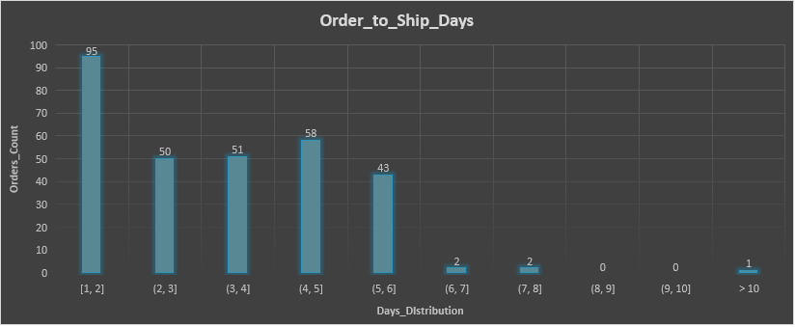
7. What are the main factors that influence customer loyalty and repeat purchases?
Key Factors Influencing Customer Loyalty:
1. Efficient Delivery:
Early or on-time deliveries positively influence customer satisfaction and loyalty.
2. Quick Order Processing:
Orders shipped within 1-2 days are most common and likely contribute to repeat purchases.
3. Minimizing Late Deliveries:
The low number of late deliveries ensures trust and reliability in the service.
4. Product Quality:
High-quality products often result in repeat purchases and brand loyalty.

Slide 12
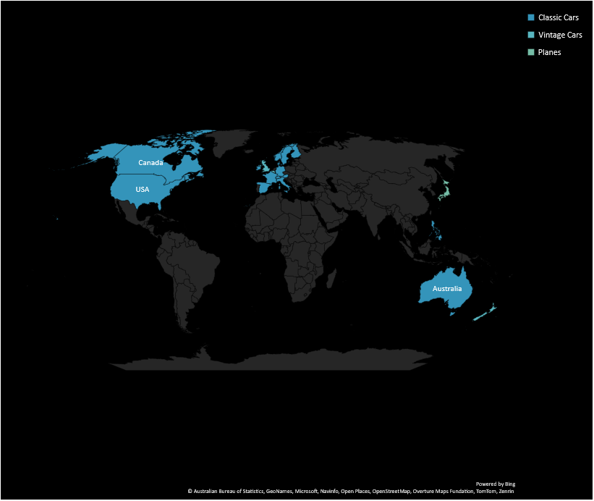
8. How do customer preferences differ based on geographic location, and how can marketing campaigns be customized accordingly?
1. For High-Performing Markets (e.g., USA, Spain, France):
Highlight premium features of Classic Cars through social media, email marketing, and ads.
Offer loyalty programs or discounts for repeat purchases in these regions.
2. For Markets with Vintage Car Demand (e.g., New Zealand, UK):
Showcase rare or collector-edition vintage cars.
Run seasonal promotions or discounts on Vintage Cars during festivals or events.
3. For Emerging Markets (e.g., Japan, Hong Kong):
Focus on promoting affordable and functional planes in these regions.
4. For Low-Performing Markets (e.g., Ireland, Sweden):
Introduce small-scale promotions to build interest, such as free shipping or low introductory prices.

Slide 13
9. What are the characteristics of high-value customers, and how can similar customers be targeted for acquisition?
Characteristics of High-Value Customers:
1. Geographic Location:
The USA appears prominently with 3 out of the top 10 customers, contributing significantly to revenue.
2. High AOV:
AOV is a significant indicator, with top customers consistently having AOV above $30,000.
3. Loyalty:
Customers with a high number of orders may exhibit brand or product loyalty, making them repeat buyers.
Recommendations for Targeting Similar Customers:
1. Geographic Expansion:
Focus marketing efforts in regions like the USA, Spain, and Australia, which are proven markets for high-value customers.
2. Promote Premium Products:
Highlight premium or high-value products in marketing campaigns, as these products likely appeal to customers with high AOV.
3. Loyalty Programs:
Offer loyalty rewards for frequent buyers to encourage repeat purchases, particularly for customers with higher order frequency.

Slide 14
12. How do customer preferences and behavior differ based on demographic factors, and how can they be leveraged for personalized marketing campaigns?
1. For High-Performing Markets (e.g., USA, Spain, France):
Highlight premium features of Classic Cars through social media, email marketing, and ads.
Offer loyalty programs or discounts for repeat purchases in these regions.
2. For Markets with Vintage Car Demand (e.g., New Zealand, UK):
Showcase rare or collector-edition vintage cars.
Run seasonal promotions or discounts on Vintage Cars during festivals or events.
3. For Emerging Markets (e.g., Japan, Hong Kong):
Focus on promoting affordable and functional planes in these regions.
4. For Low-Performing Markets (e.g., Ireland, Sweden):
Introduce small-scale promotions to build interest, such as free shipping or low introductory prices.

Slide 15
Power Bi Questions

Slide 16
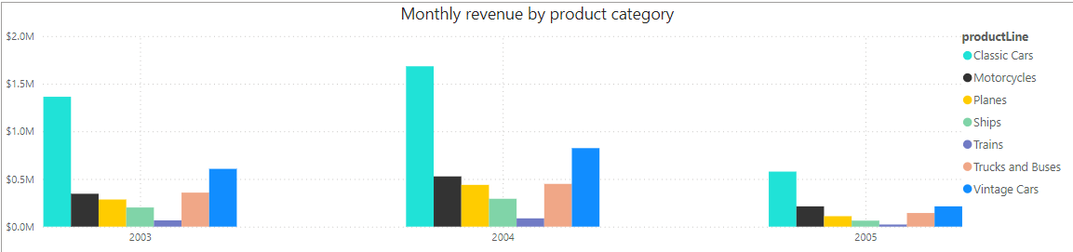
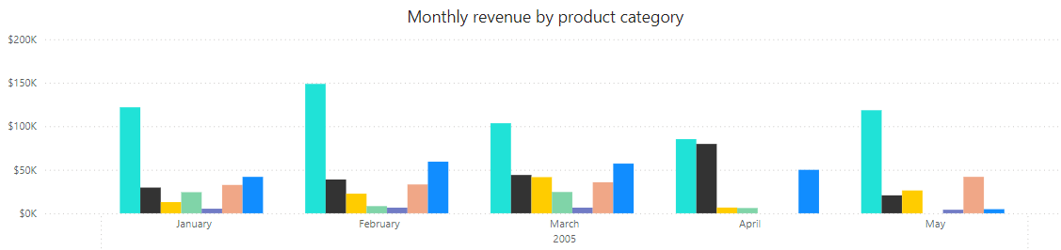
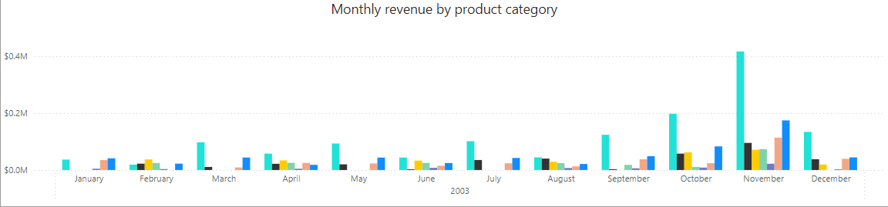
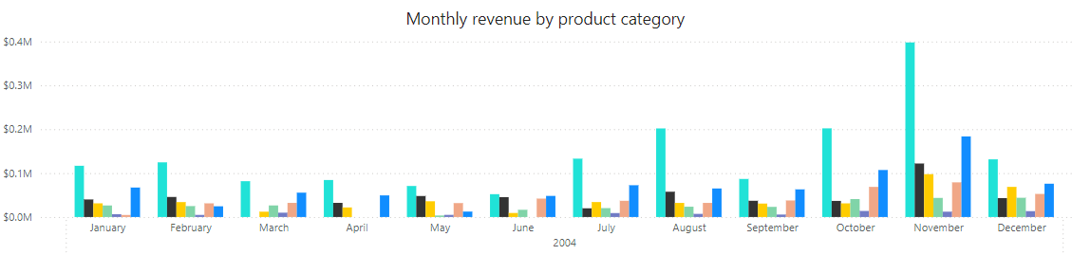
1.How does monthly revenue vary across different product categories?

Slide 17
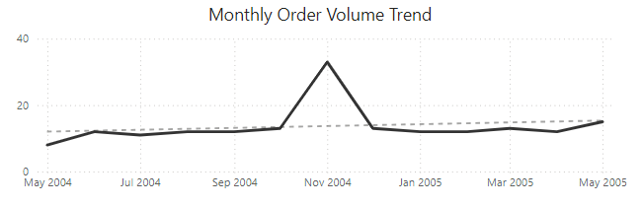
2. What is the trend in customer order volume over the past year?

Slide 18
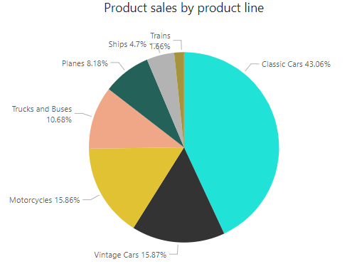
3.What is the distribution of product sales across different product lines?

Slide 19
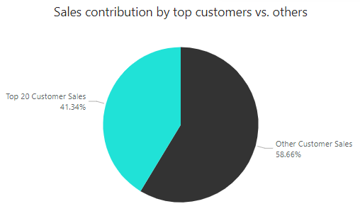
4. How does the sales performance of top customers compare to the rest?

Slide 20
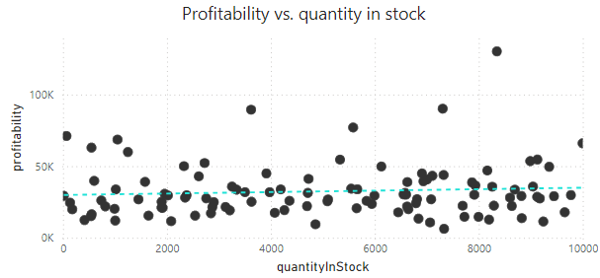
5. How does the profitability of different products compare based on their quantity in stock?

Slide 21
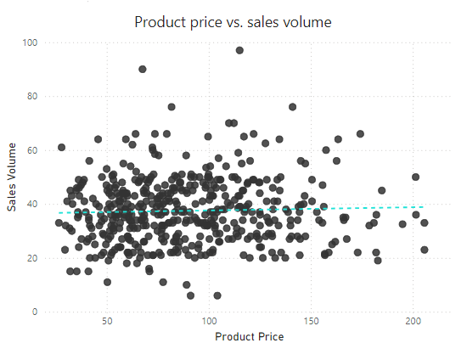
6. How does product pricing impact sales volume?

Slide 22
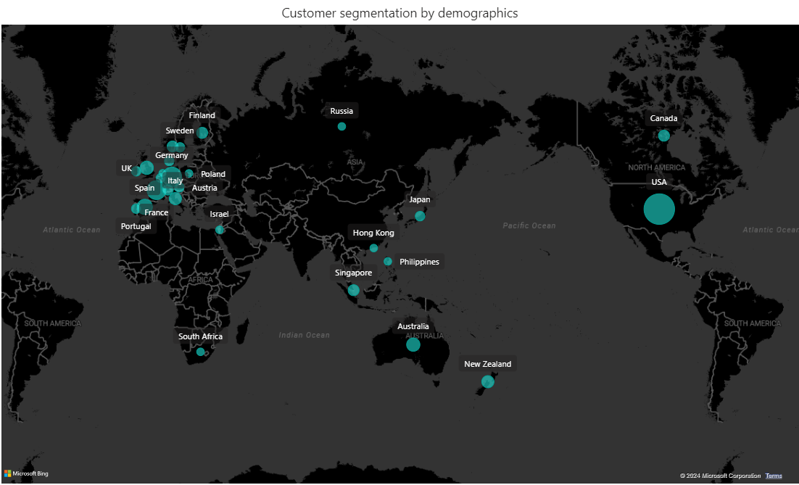
7. What is the distribution of customers across different demographic segments?

Slide 23
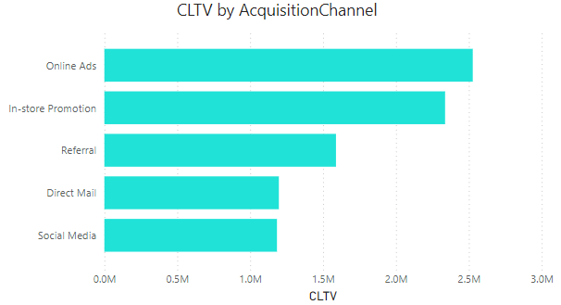
8. How does customer lifetime value vary for different customer acquisition channels?

Slide 24
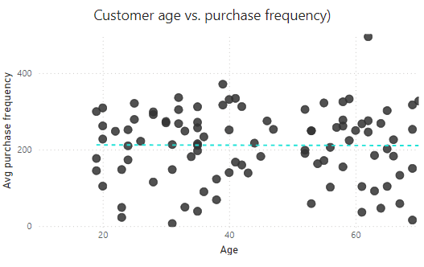
9. What is the correlation between customer age and purchase frequency?

Slide 25
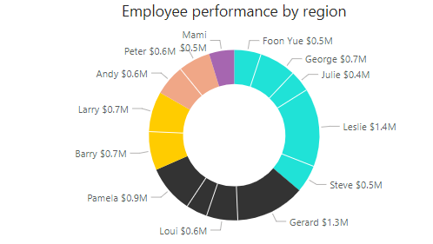
10.How does the performance of sales employees vary across different regions?

Slide 26
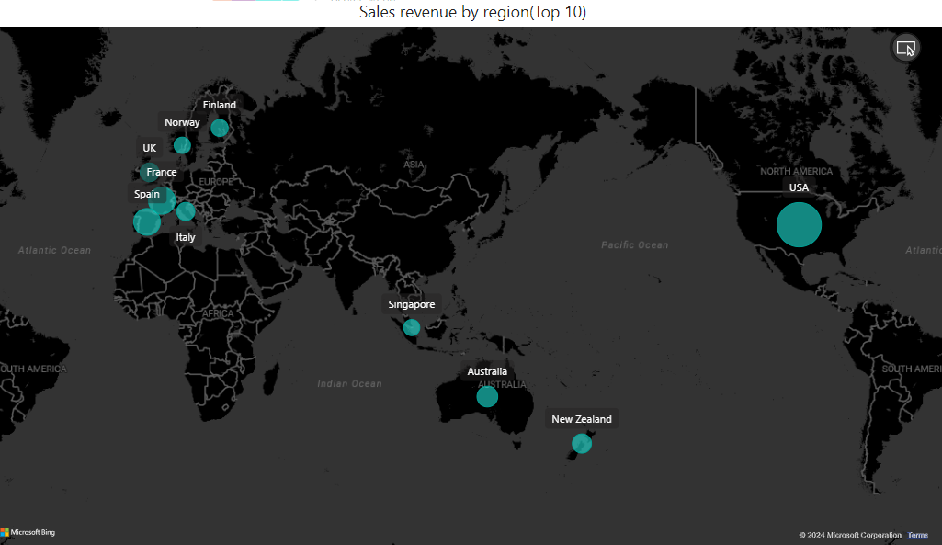
11. What are the top regions in terms of sales revenue?

Slide 27
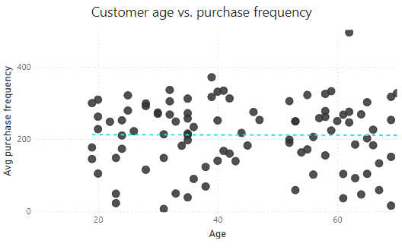
12. What is the correlation between customer demographics and purchase frequency?

